Slide 1
Java Architecture

Slide 2
What is java Architecture?
Java architecture is a collection of components, i.e., JVM, JRE, and JDK
It integrates the process of interpretation and compilation.
It defines all the processes involved in creating a java program.

Slide 3
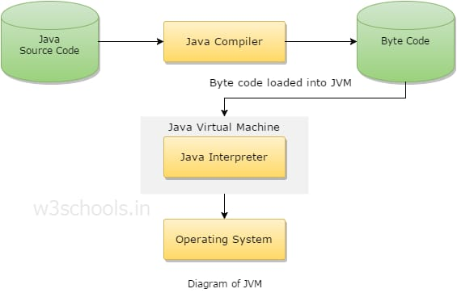

Slide 4
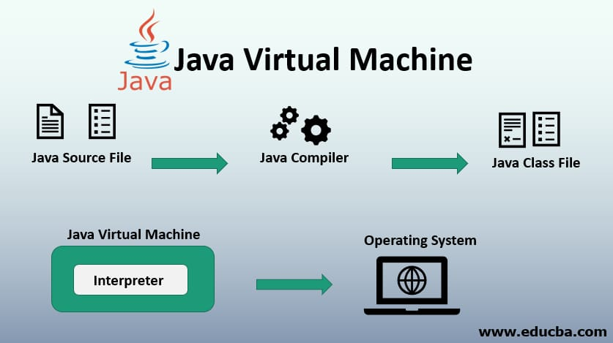
What is JVM?
JVM- Java virtual machine
A java virtual machine is a virtual machine that enables a computer to run java programs as well as programs written in other languages that are also compiled to java byte code

Slide 5
What is JDK,JRE
JDK-java Development Kit
JDK is bundle of software development tools and supporting libraries combined with the java Runtime Environment
JRE-Java Runtime environment
JRE is software that java programs require to run correctly

Slide 6
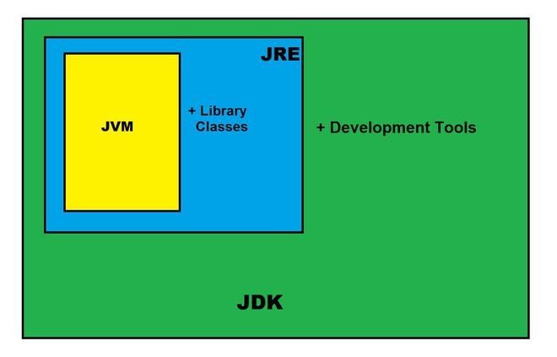

Slide 7
Conclusion:
JDK is used to develop java applications. And it also contains numerous development tools like compilers, debuggers etc
JRE is the implementation of JVM and it is specially designed to execute java programs

Slide 8
Thank You

